Slide 1



Creating Graphical User Interface
(GUI & Swing, Part 1)
Java GUI and the swing package
References:
Textbook, chapter 10, 11
Java-Tutorials/tutorial-2015/uiswing/index.html

Slide 2
Objectives
What is a GUI application?
Common Swing Methods
Basic Swing Components
JTable
JTree
Events Handling
Panes
Good GUI

Slide 3
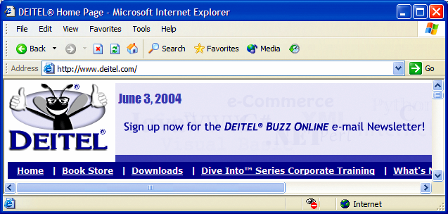
What is a GUI application?
A GUI is a graphical (rather than purely textual) user interface to a computer. The picture below is an example for GUI application:
button
menus
title bar
menu bar
combo box
scroll
bars

Slide 4
How to create Java GUI applications?
A Java GUI application uses the standard Java components GUI component set, AWT and Swing, and is deployed to the desktop.
Java provides two sets of components for GUI programming:
  AWT: classes in the java.awt package
  Swing: classes in the javax.swing package
AWT = Abstract Window Toolkit
"Swing" was the code name of the project that developed the new components.

Slide 5
Swing vs AWT
AWT is Java’s original set of classes for building GUIs
  Uses peer components of the OS (heavyweight)
  Not truly portable: looks different and lays out inconsistently on different OSs
    Due to OS’s underlying display management system
Swing is designed to solve AWT’s problems
  Swing implements GUI components that build on AWT technology.
  Swing is implemented entirely in Java. Its' components do not depend on peers to handle their functionality. Thus, these components are often called lightweight components.
  Truly portable: Lays out consistently on all OSs
  Uses AWT event handling

Slide 6
Some AWT and Swing Classes
java.lang.Object
java.awt.Component
java.awt.Container
javax.swing.JComponent
java.awt.Window
javax.swing.JPanel
java.awt.Frame
javax.swing.JFileChooser
javax.swing.JPopupMenu
javax.swing.JFrame
javax.swing.JToolbar
javax.swing.JLabel

Slide 7
About Java Foundation Classes
JFC encompass a group of features for building graphical user interfaces (GUIs) and adding rich graphics functionality and interactivity to Java applications. It is defined as containing the features shown in the table below:
Feature | Description
Swing GUI Components | Includes everything from buttons to split panes to tables. Many components are capable of sorting, printing, and drag and drop, to name a few of the supported features.
Pluggable Look-and-Feel Support | Allowing a choice of look and feel. For example, the same program can use either the Java or the Windows look and feel. Additionally, the Java platform supports the GTK+ look and feel, which makes hundreds of existing look and feels available to Swing programs. Many more look-and-feel packages are available from various sources.
Accessibility API | Enables assistive technologies, such as screen readers and Braille displays, to get information from the user interface.
Java 2D API | Enables developers to easily incorporate high-quality 2D graphics, text, and images in applications and applets. Java 2D includes extensive APIs for generating and sending high-quality output to printing devices.
Internationalization | Allows developers to build applications that can interact with users worldwide in their own languages and cultural conventions. With the input method framework developers can build applications that accept text in languages that use thousands of different characters, such as Japanese, Chinese, or Korean.

Slide 8
Swing Packages
javax.accessibility
javax.swing.plaf
javax.swing.text.html
javax.swing
javax.swing.plaf.basic
javax.swing.text.parser
javax.swing.border
javax.swing.plaf.metal
javax.swing.text.rtf
javax.swing.colorchooser
javax.swing.plaf.multi
javax.swing.tree
javax.swing.event
javax.swing.table
javax.swing.undo
javax.swing.filechooser
javax.swing.text

Slide 9
Common Swing Methods
getSize() and setSize()
getLocation() and setLocation()
setForeground() and setBackground()
setFont()
setEnabled()

Slide 10
Basic Swing Components
The Swing component classes can be found in the javax.swing package. The component class names all begin with the letter J.
There are 3 categories:
  Container components
  Ordinary components
  Menu components

Slide 11
Container Components
Container components are components that can contain other components (including other containers).
Containers use layout managers to determine the size and position of their child components.

Slide 12
Container: JFrame
A JFrame is an independent window that can be moved around on the screen independently of any other GUI windows.
Any application that requires a GUI must use one or more frames to contain the desired components.

Slide 13
Container: JPanel
JPanel is a generic lightweight container.
A JPanel is a blank rectangular component that can contain other components.
Each panel uses a layout manager to determine the position and size of its child components.
A lightweight component is one that "borrows" the screen resource of an ancestor (which means it has no native resource of its own -- so it's "lighter").

Slide 14
Difference between JFrame & JPanel - 1
JPanel serves as a general purpose container, while JFrame is a window commonly used for stand-alone applications, like a warning window, or a notification window.
JPanel represents an area used for more complex operations or applications.
In JPanel, one panel can hold many operations, while in JFrame, it can have inner frames for a different purpose.

Slide 15
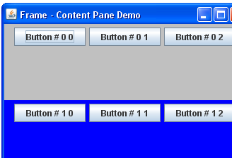
Difference between JFrame & JPanel - 2
JFrame f = new JFrame("Frame - Content Pane Demo");
f.setSize(350, 250);
f.setDefaultCloseOperation(JFrame.EXIT_ON_CLOSE);
Container cont = f.getContentPane();
JPanel pan;
int i, j;
cont.setLayout(new GridLayout(2,1));
for(i=0; i<2; i++)
{pan = new JPanel();
pan.setBackground(i==0 ? Color.lightGray : Color.blue);
for(j=0; j<3; j++) pan.add(new JButton("Button # " + i + " " + j));
cont.add(pan);
}
f.setVisible(true);

Slide 16
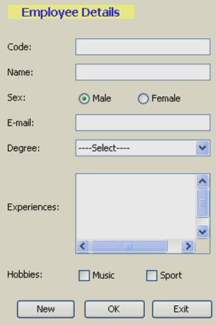
Ordinary Components
JLabel
JTextfield
JRadioButton (ButtonGroup)
JComboBox
JTextArea
JScrollBar
JCheckBox
JButton

Slide 17
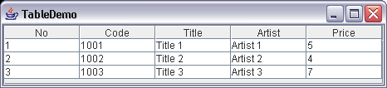
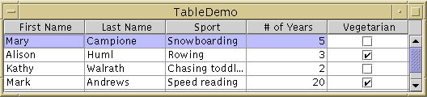
JTable
With the JTable class you can display tables of data, optionally allowing the user to edit the data. JTable doesn't contain or cache data; it's simply a view of your data.

Slide 18
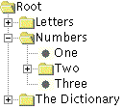
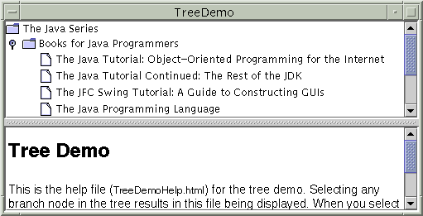
JTree
With the JTree class, you can display hierarchical data. A JTree object doesn't actually contain your data; it simply provides a view of the data.

Slide 19
Model-View-Controller (MVC)
The hard problem in O-O programming is deciding what objects to have, and what their responsibilities are
Design Patterns describe the higher-level organization of solutions to common problems
Design patterns are a major topic in O-O design
MVC Design pattern often used in Swing objects. MVC breaks a GUI object down into three parts:
  “Model” manages the data used by the object
  “View” manages the graphical/textual output of the object
  “Controller” interprets user input, commanding the model and view to change as necessary.
  These three components are usually implemented as separate classes.

Slide 20
MVC - Combining Controller and View
Sometimes the Controller and View are combined, especially in small programs
Combining the Controller and View is appropriate if they are very interdependent
The Model should still be independent
Never mix Model code with GUI code!

Slide 21
MVC - Separation of concerns
As always, you want code independence
The Model should not be contaminated with control code or display code
The View should represent the Model as it really is, not some remembered status
The Controller should talk to the Model and View, not manipulate them
  The Controller can set variables that the Model and View can read

Slide 22

MVC demo - The “Reverser” program
In this program we combine the Controller and the View (indeed, it’s hard to separate them)
The Model, which does the computation (reversing the string), we put in a separate class

Slide 23
MVC demo - ReverserGUI.java
A bunch of import statements, then...
public class ReverserGUI extends JFrame {
ReverserModel model = new ReverserModel();
JTextField text = new JTextField(30);
JButton button = new JButton("Reverse");
public static void main(String[] args) {
ReverserGUI gui = new ReverserGUI();
gui.create();
gui.setDefaultCloseOperation(JFrame.EXIT_ON_CLOSE);
}
... create()...
}

Slide 24
MVC demo - The create method
private void create() {
setLayout(new GridLayout(2, 1));
add(text);
add(button);
button.addActionListener(new ActionListener() {
public void actionPerformed(ActionEvent arg0) {
String s = text.getText();
s = model.reverse(s);
text.setText(s);
}
});
pack();
setVisible(true);
}

Slide 25
MVC demo - The Model
public class ReverserModel {
public String reverse(String s) {
StringBuilder builder = new StringBuilder(s);
builder.reverse();
return builder.toString();
}
}

Slide 26
Handling Events - 1
Every time the user types a character or pushes a mouse button, an event occurs.
Any object can be notified of the event. All the object has to do is implement the appropriate interface and be registered as an event listener on the appropriate event source.

Slide 27
Handling Events - 2
public class SwingApplication implements ActionListener {
...
JButton button = new JButton("I'm a Swing button!");
button.addActionListener(this);
....
public void actionPerformed(ActionEvent e) { numClicks++;
label.setText(labelPrefix + numClicks);
}
}

Slide 28
Handling Events - 3
Every event handler requires three pieces of code:
Declaration for the event handler class
  public class Handler implements ActionListener {..}
Registers an instance of the event handler class as a listener on one or more components.
  component.addActionListener(instanceOf Handler );
The event handler class has code that implements the methods in the listener interface.
  public void actionPerformed(ActionEvent e) {
    ...//code that reacts to the action...
  }

Slide 29
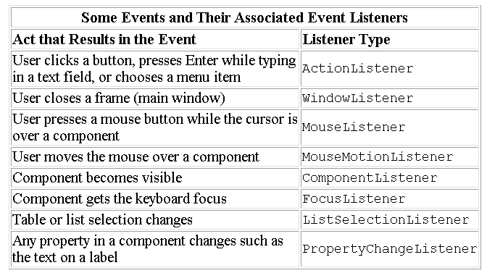
Events

Slide 30
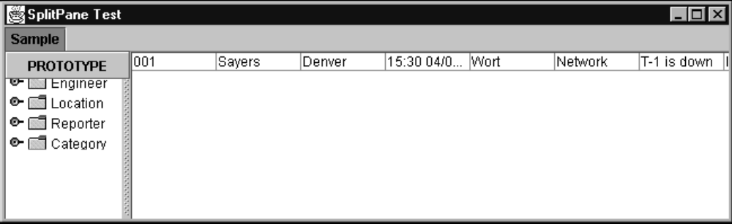
SplitPanes
JSplitPane

Slide 31
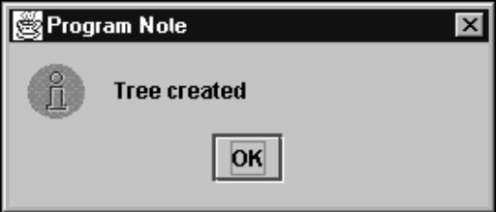
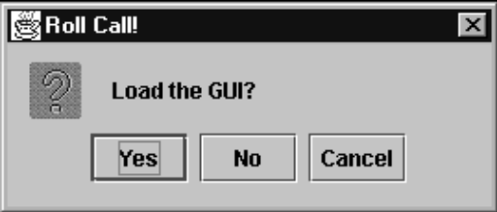
OptionPane
JOptionPane

Slide 32
Main Steps in GUI Programming
To make any graphic program work we must be able to create windows and add content to them.
To make this happen we must:
  Import the awt or swing packages.
  Set up a top-level container.
  Fill the container with GUI components.
  Install listeners for GUI Components.
  Display the container.

Slide 33
Good GUI
Easy to Learn
Easy to use
Attractive

Slide 34
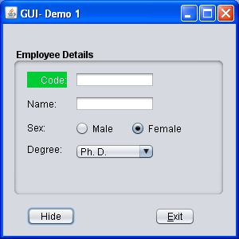
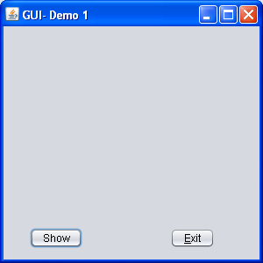
Demo 1 - 1
Objectives
Use a panel to group some components
Hide and show those as a whole through this panel
Disable the exit button on the frame
The exit button allows user close the application
GUI:

Slide 35
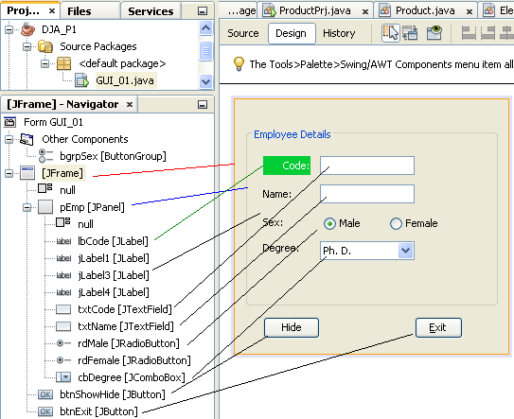
Demo 1 - 2
Design

Slide 36
Demo 1 - 3
Setup Properties
Class | Object name | Properties
JFrame | GUI_01 | Layout: null, defaultCloseOperation: DO_NOTHING Title: GUI-Demo 1
JPanel | pEmp | Layout: null, Border: tittleBorder
JLabel | lbCode | Opaque: true, background: green, foreground: white horizontalAlignment: RIGHT, text: Code
JLabel | others | Text: Name, Sex, Degree
ButtonGroup | bgrpSex
JRadioButton | rdMale | buttonGroup: bgrpSex, Text: Male, Selected: true,
JRadioButton | rdFemale | buttonGroup: bgrpSex, Text: Female, Selected: false
JComboBox | cbDegree | Model:Ph. D., Master, Engineer, Bachelor, Technician
Button | btnHideShow | Text: Hide
JButton | btnExit | Text: Exit, mnemonic: E, TooltipText: Exit program

Slide 37
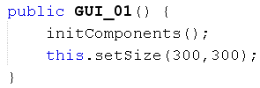

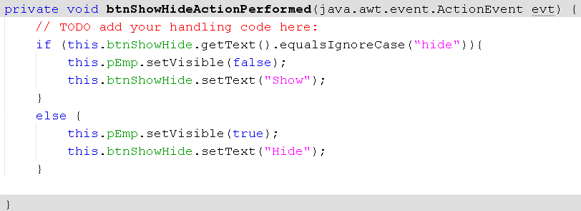
Demo 1 - 4
Code:
Constructor
Code for handling the event on the button Exit
Code for handling the event on the button ShowHide

Slide 38
Demo 1 - 5
View code at the end of the source file, inserted by NetBeans → Comment
View the contents of the method initComponents(), inserted by NetBeans, to explore anonymous classes, then verify them using Window Explorer

Slide 39
Summary
What is a GUI application?
Common Swing Methods
Basic Swing Components
JTable
JTree
Events Handling
Panes
Good GUI

